Slide 1
My Notes
Submitted To
Vijeta Kumawat
HOD CS branch
JECRC UDML College of
Engineering
Submitted By
Vikash Gaurav

Slide 2
Project Objective
To develop an Interactive Android app which provides :
Users to add their events

Slide 3
What I learnt?
Technical Learning
Android Programming
Fragmentation.
SQLite Database
Material Design
Android Web-viewer.
Firebase

Slide 4
Introduction
Smartrip permits user to make their Trip.
This app have basically three sections first is for Trains, second is for Flights and last is for Buses.
In the Trains section user can check their PNR status, offline Routes of the trains, Train running status.
In the flights section user can Track their flights, they can have fare alerts of the flights, they can Book a cab through UBER cab booking app.
In the Bus section user can search their buses.

Slide 5
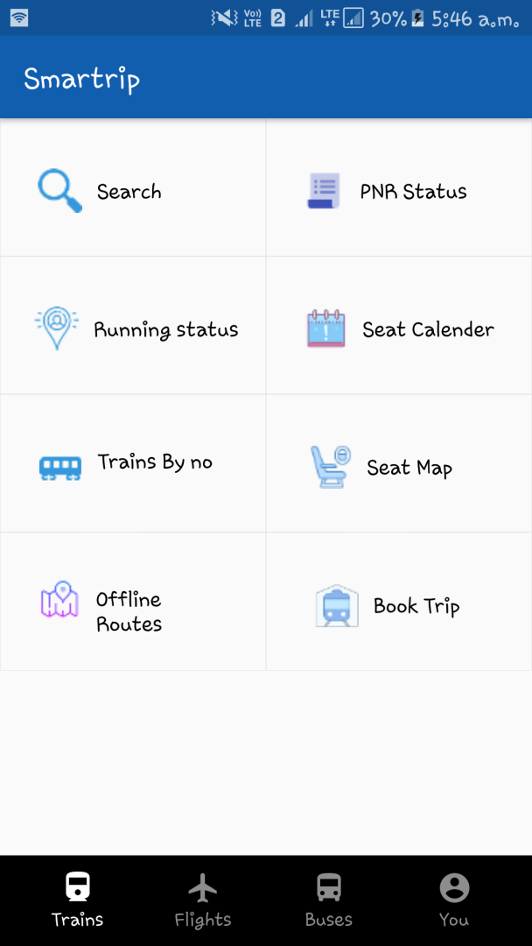
Main Activity
Trains
This is main Activity of my application i.e. Trains section.
In this section there is too many functions like Search, Check PNR, Running status, Book.
User can do their desired work by clicking on any of these options.

Slide 6
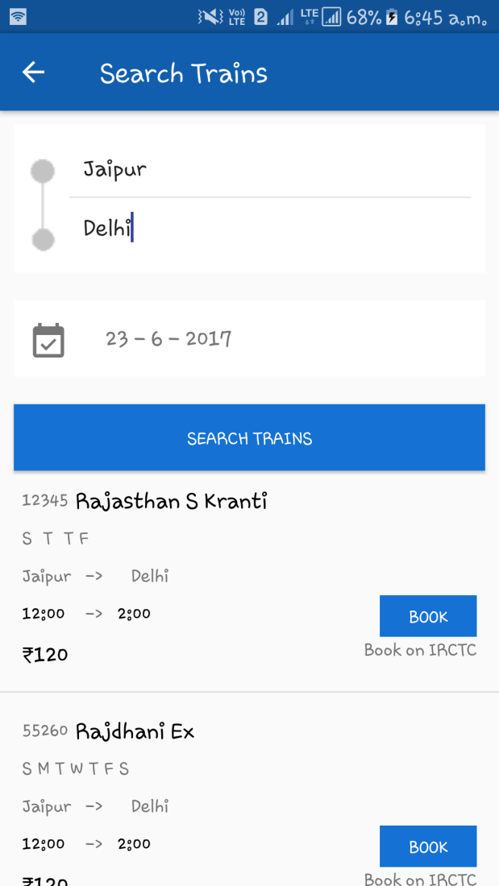
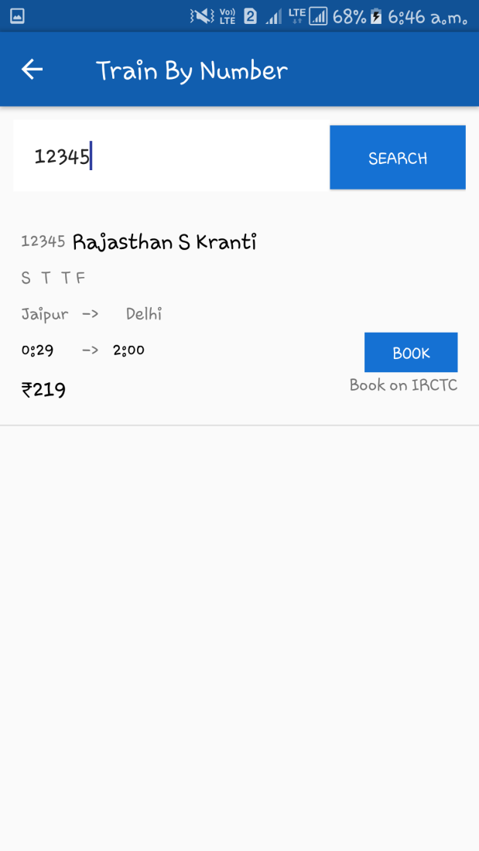
Screenshots

Slide 7
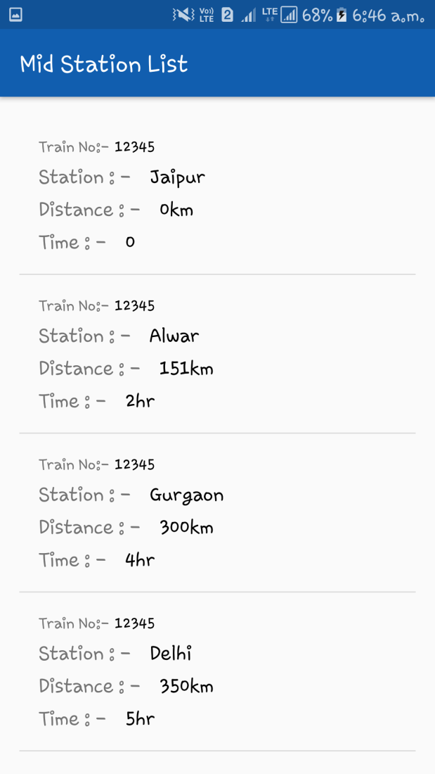
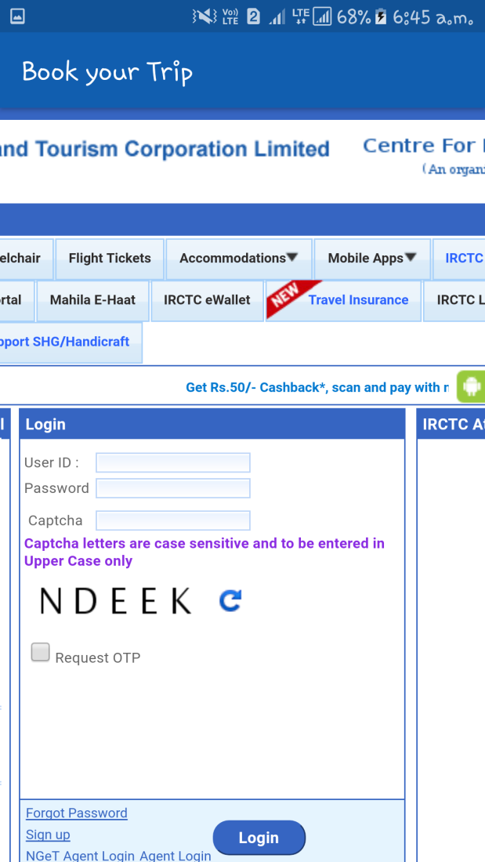
Screen Shots

Slide 8
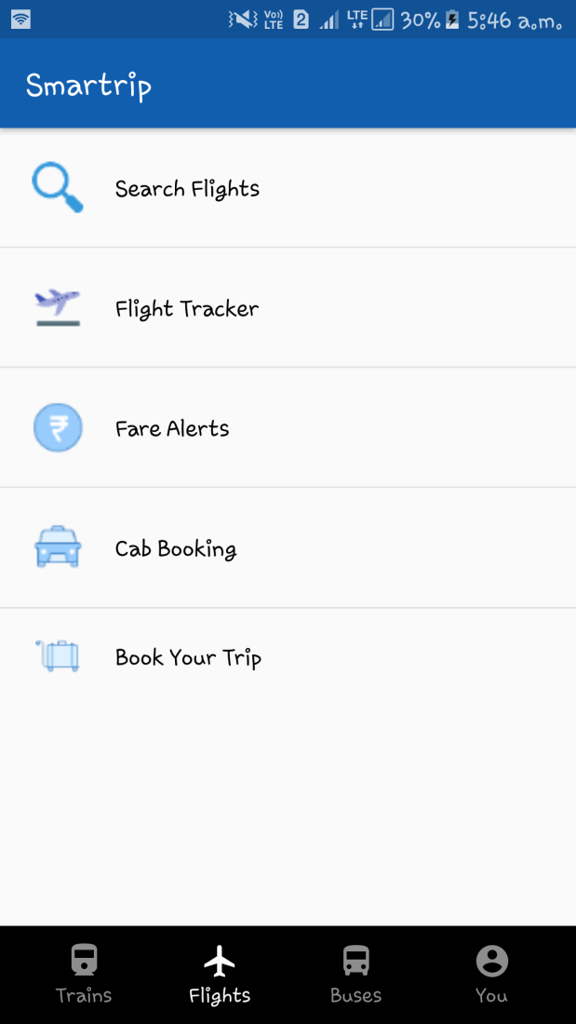
Second Activity
Flights
This is the second Activity of my application i.e. Flights section.
In this section user can search their flights, track their flights, fare alerts, book a cab through UBER cab Booking App and lastly book their flights.

Slide 9
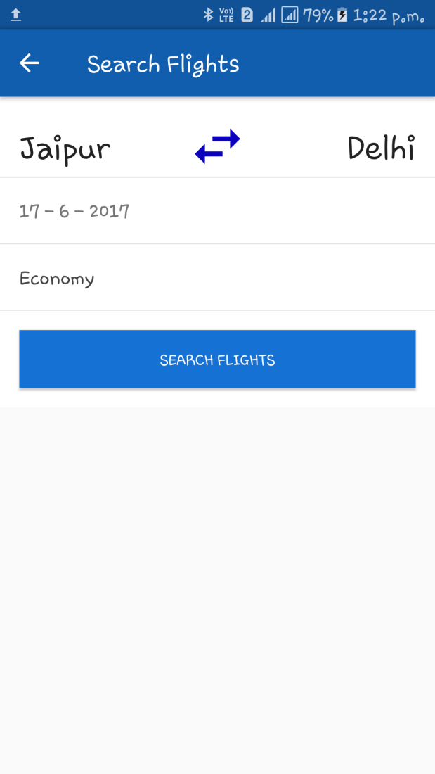
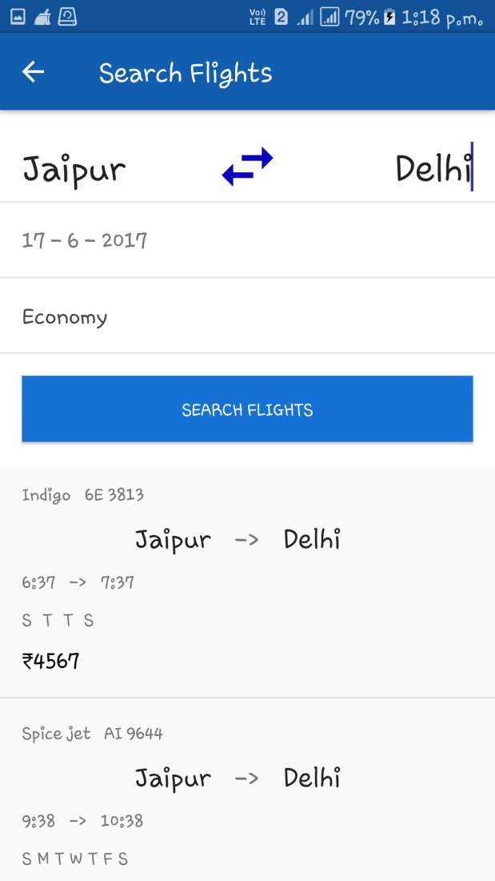
Screenshots

Slide 10
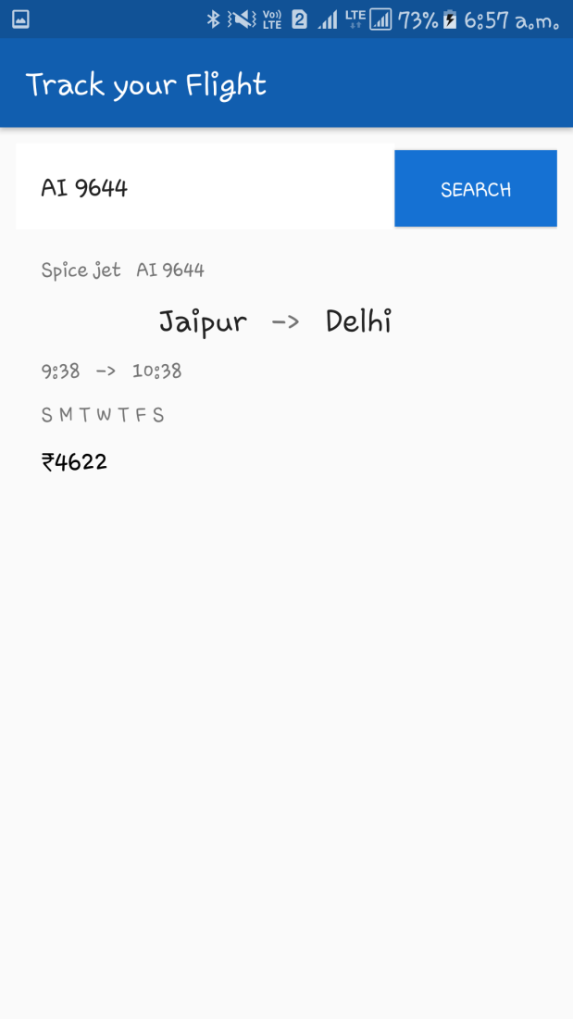
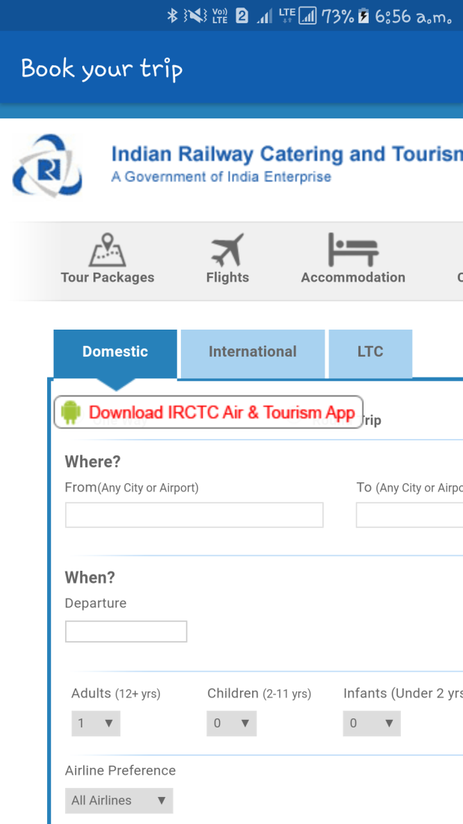
Screenshots

Slide 11
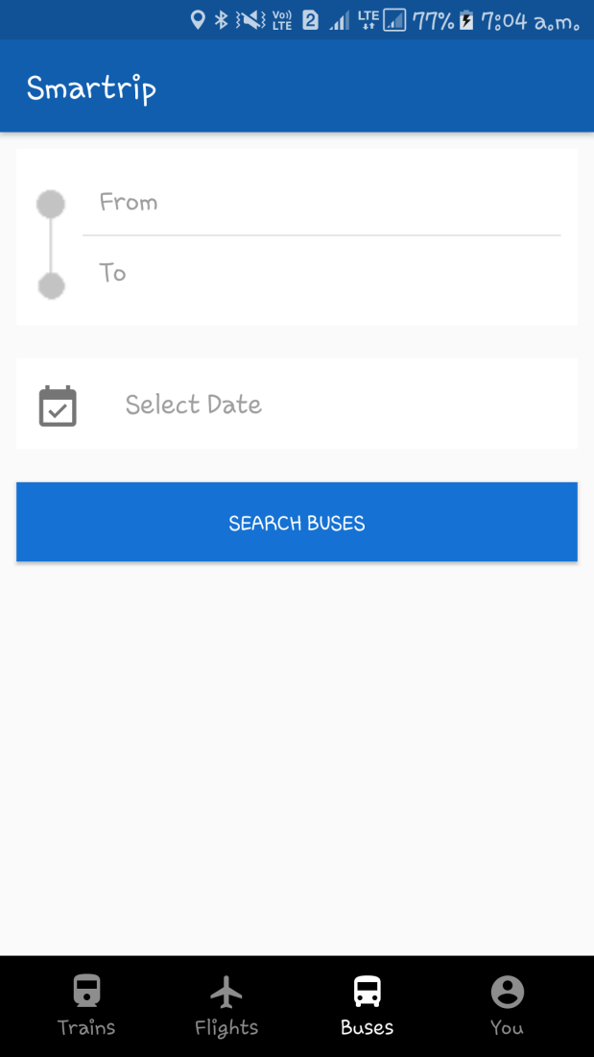
Third Activity
Buses
This is the third Activity i.e. Buses section.
In this activity user can find their buses across the cities.

Slide 12
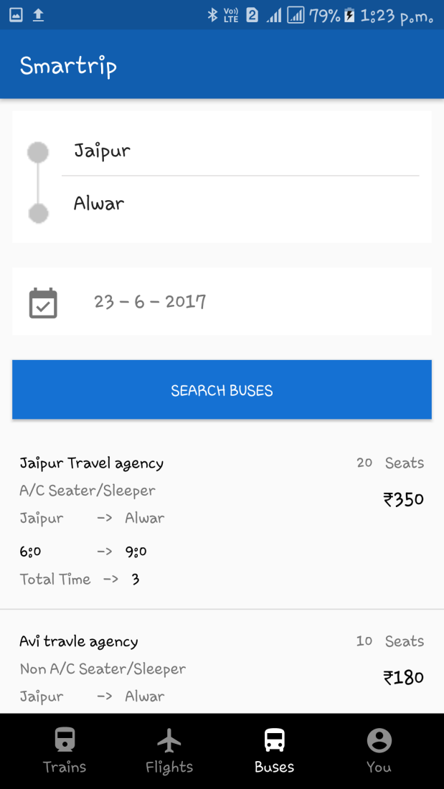
Screenshots

Slide 13
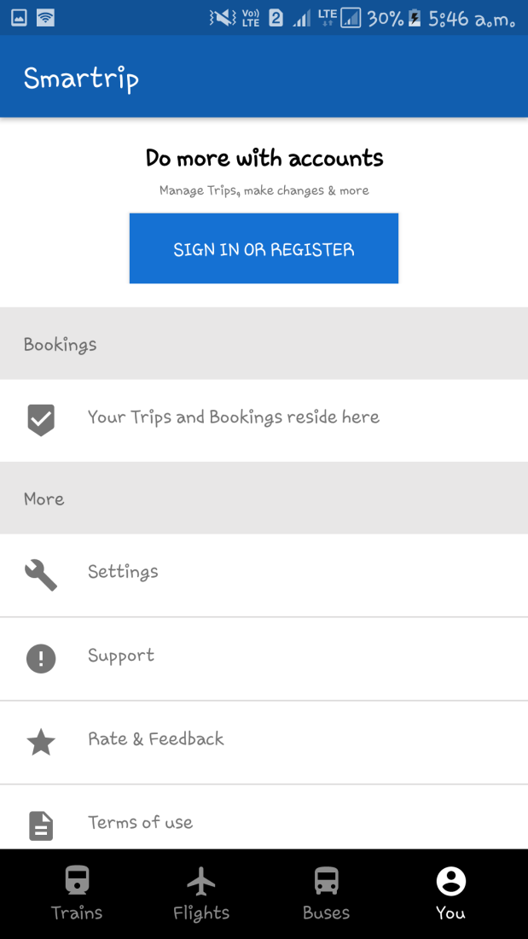
Fourth Activity
You
This is fourth Activity i.e. You section.
In this section user can Sign In or Register to see their booked trips and for give us feedback and for more settings.

Slide 14
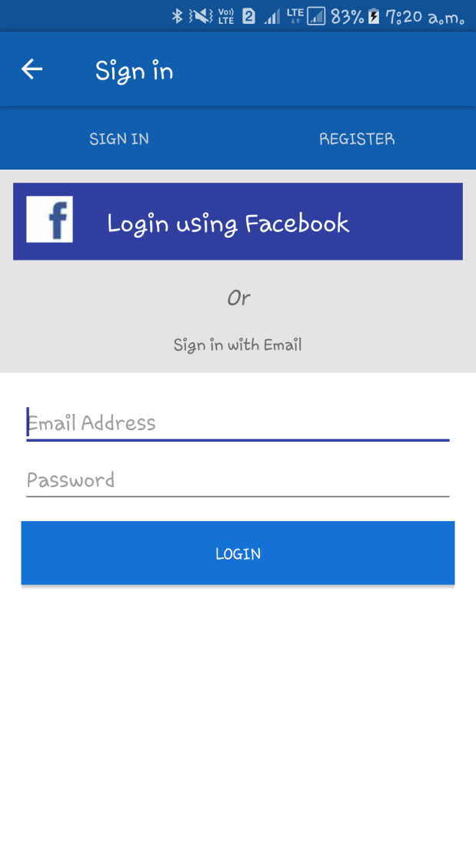
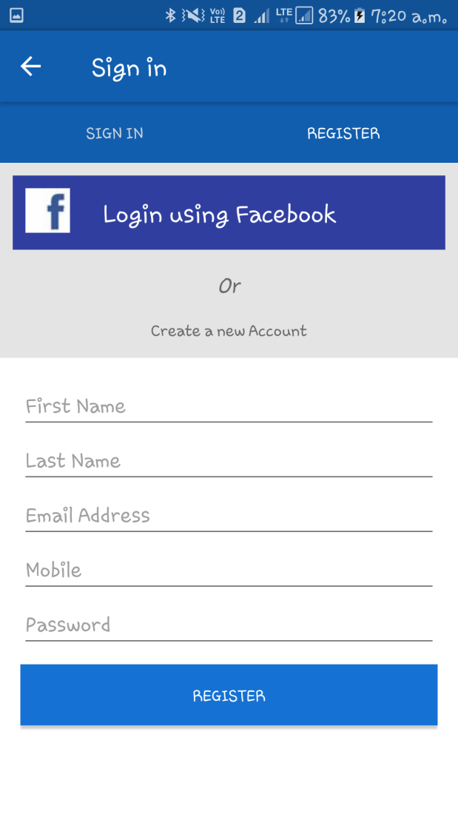
Screenshots

Slide 15
End Users?
Office Worker.
Android Users.
Students.

Slide 16
Context Diagram

Slide 17
Smartrip
Trains
Search Trains
PNR Status
Flights
Running Status
Seat Calendar
Trains By no
Seat map
Offline Routes
Book trip
Book your Tri
Cab Booking
Fare Alerts
Flight Tracker
Search Flights
Buses
You
Sign In
Register
Feedback

Slide 18
Swot Analysis

Slide 19
Strength
Simple Interface and processes
Good customer support for users
Highly Customer oriented.

Slide 20
Weakness
Unable to attract users who are not internet savvy
There is no any option for direct payment
Some security issues.

Slide 21
Opportunity
Customers currently using traditional methods of bookings
There are many section which help users to save their times

Slide 22
Threats
There are many apps which have more functions
Some apps like Make my trip gives trip packages.

Slide 23
Future enhancement
Designing our own Web-viewer instead of using Android provided web-viewer
Work on Security i.e. users details will be more secure.
Add some more features like give user a package trip and add own payment options.

Slide 24
Refrences
http://www.developer.android.com/
http://www.stackoverflow.com/
http://www.youtube.com/

Slide 25
Thank you

